Slide 1

Lead Mate AI Engineer Strategist
Supervisor:
Dr. Anand Kakarla,
School of Technology,
Woxsen University
Team Members:
Nikunj Gupta – 22WU0104153(AIML)
Vastav – 22WU0105034(DS)
Sanjay Bukka – 22WU0104159(AIML)

Slide 2
Introduction
LeadMate is an AI-powered strategic layer for project management. It goes beyond traditional tools by actively reasoning about your project and team to provide proactive, actionable insights.
Think of it as having an experienced tech strategist on your team—one that has read every line of code, understands every team member's skills, and knows every project requirement.
Key features include:
AI-driven role allocation and skill gap analysis
Context-aware stack recommendations
Intelligent commit tracking and risk flagging
Natural language chat with your entire codebase and documentation

Slide 3
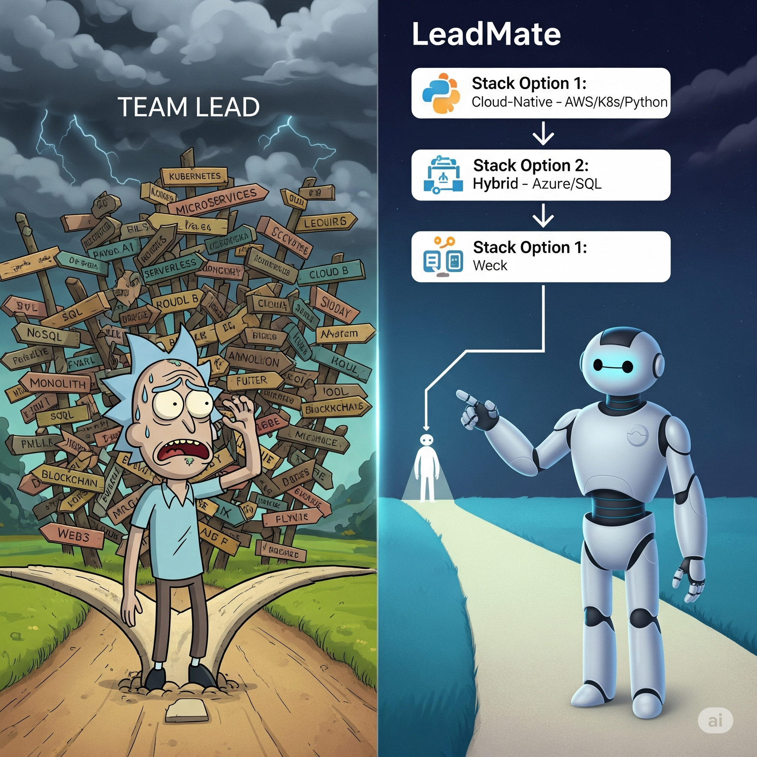
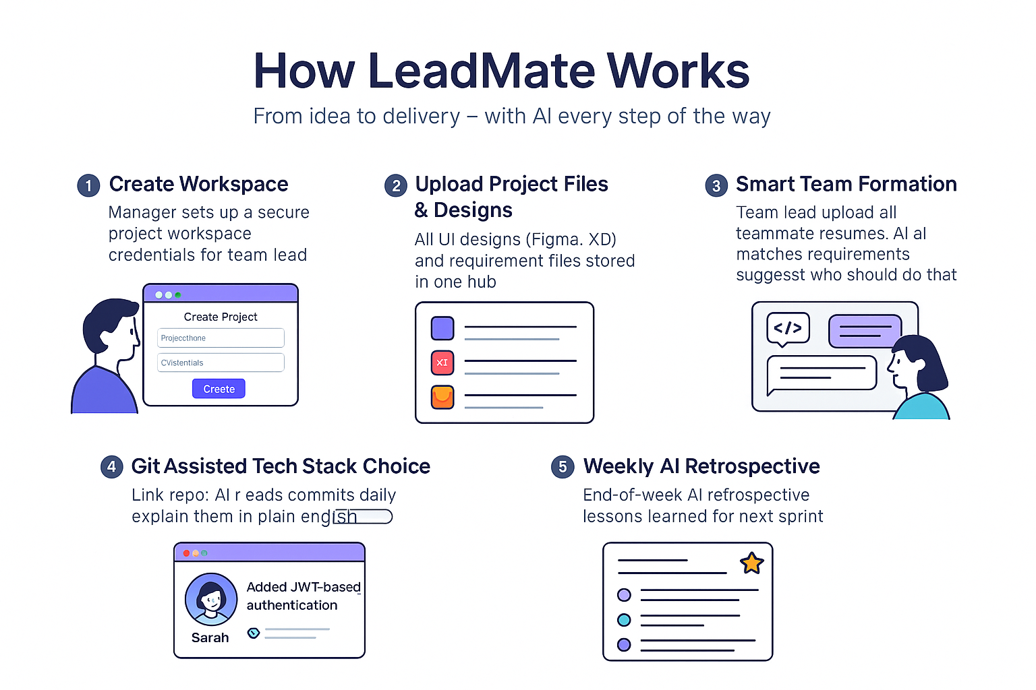
Problem Statement

Slide 4
Project Objectives
Centralized Workspace – Single hub for project assets & team management.
AI Role Assignment – Match members to roles based on resumes & skills.
Skill Gap Alerts – Detect missing expertise, suggest training or hiring.
AI Tech Stack Advisor – Recommend stack based on project needs & team skills.
GitHub Integration – Read codebase, track commits, and summarize changes.
Commit Summaries – Explain before/after code changes automatically.
Progress Tracking – Monitor activity & give weekly AI retrospectives.
AI–Lead Chat – Context-aware discussions on code & progress.

Slide 5
Literature Review / Existing Work
Jira / Trello
Asana
Linear / ClickUp
GitHub Copilot / Codeium
Slack + AI Bots
Gap Identified: No single platform offers end-to-end project management with AI-driven role allocation, tech stack advice, commit analysis, and continuous retrospectives in one integrated workspace.
CodeBERT: A Pre-Trained Model for Programming and Natural Languageslink: https://arxiv.org/abs/2002.08155
eq2Seq Attention Model Summarizes Code Diffs
link: https://arxiv.org/abs/1904.10838

Slide 6
Novelty
Existing Tool | What It Offers | LeadMate Novelty
Jira | Task tracking, sprint planning | Adds AI that understands code changes & provides commit explanations
Trello | Visual task boards | Integrates codebase insights into task boards automatically
GitHub | Version control, commit history | Explains commits in plain language, identifies impact on project goals
Asana | Task assignments, timelines | Runs AI skill gap analysis & suggests training/hiring
ClickUp | Task + docs management | Direct repo integration + management dashboard with both technical & non-technical summaries

Slide 7
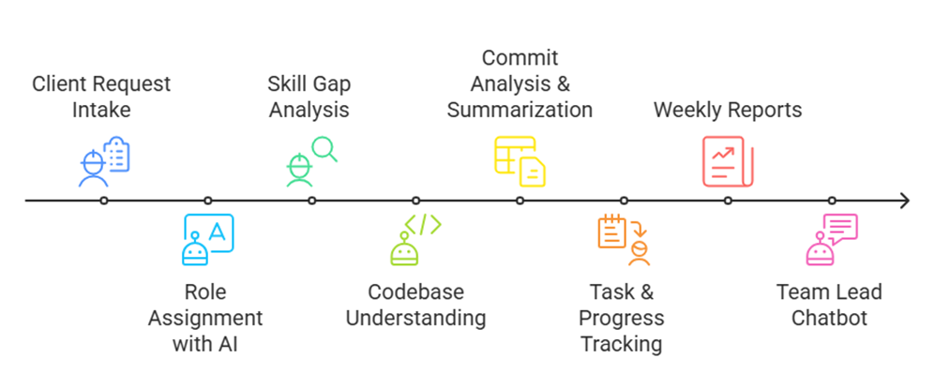
Proposed Methodology

Slide 8
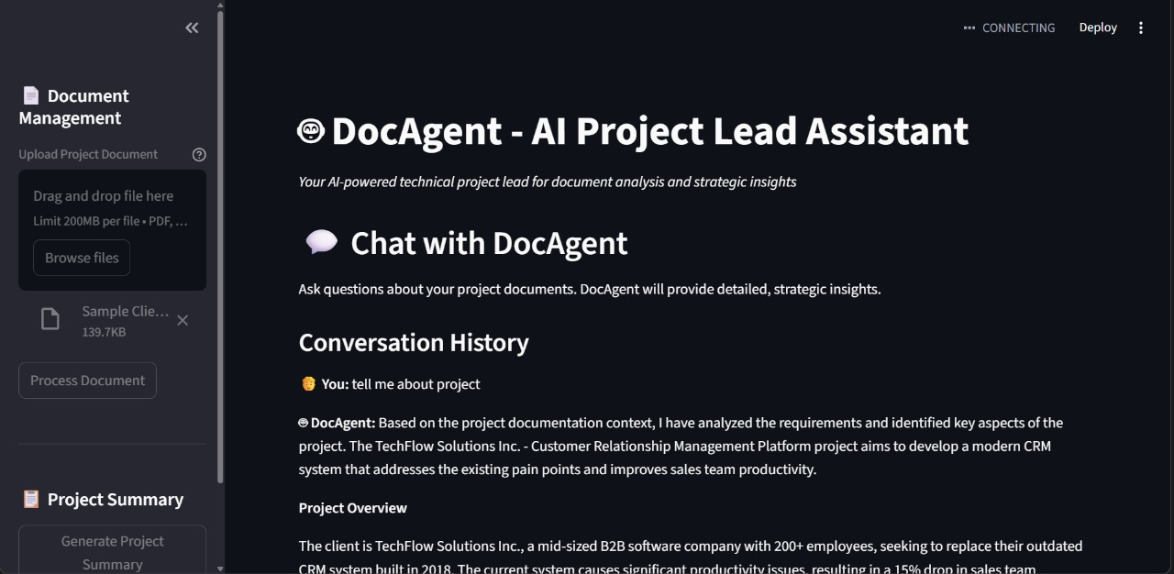

Slide 9
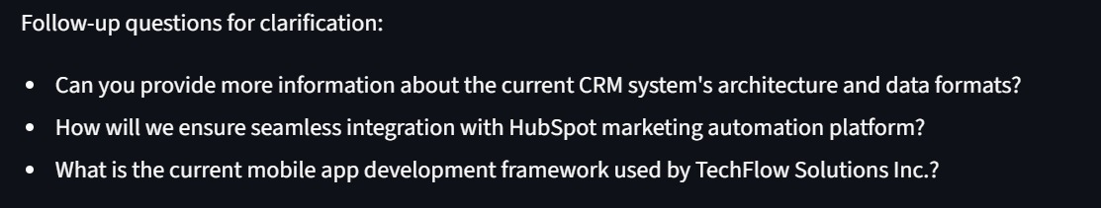
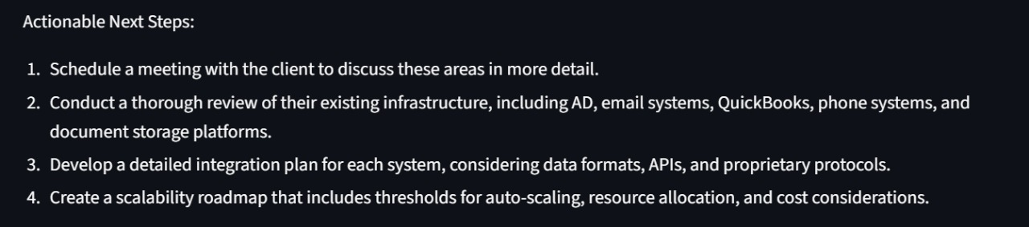

Slide 10

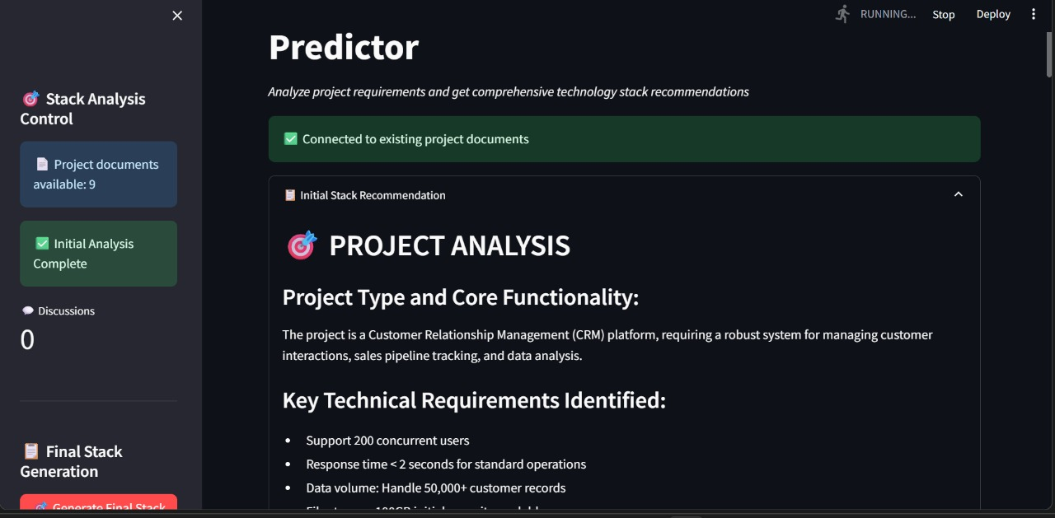

Slide 11
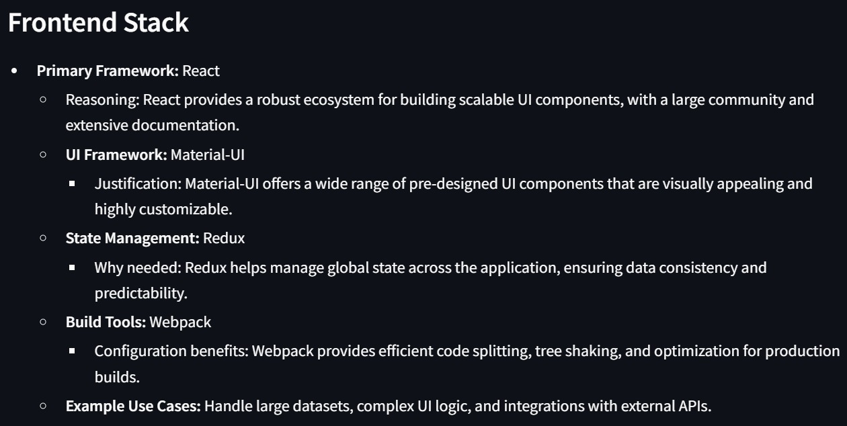

Slide 12
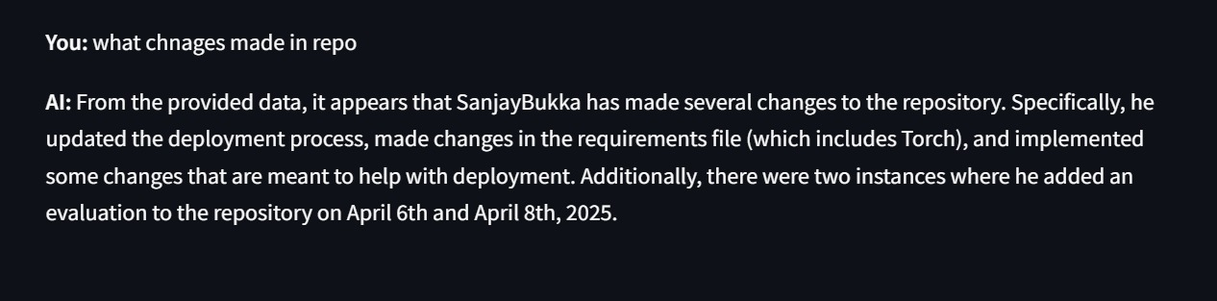

Slide 13
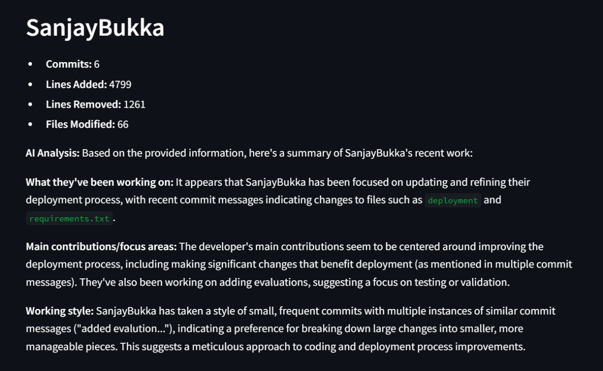

Slide 14
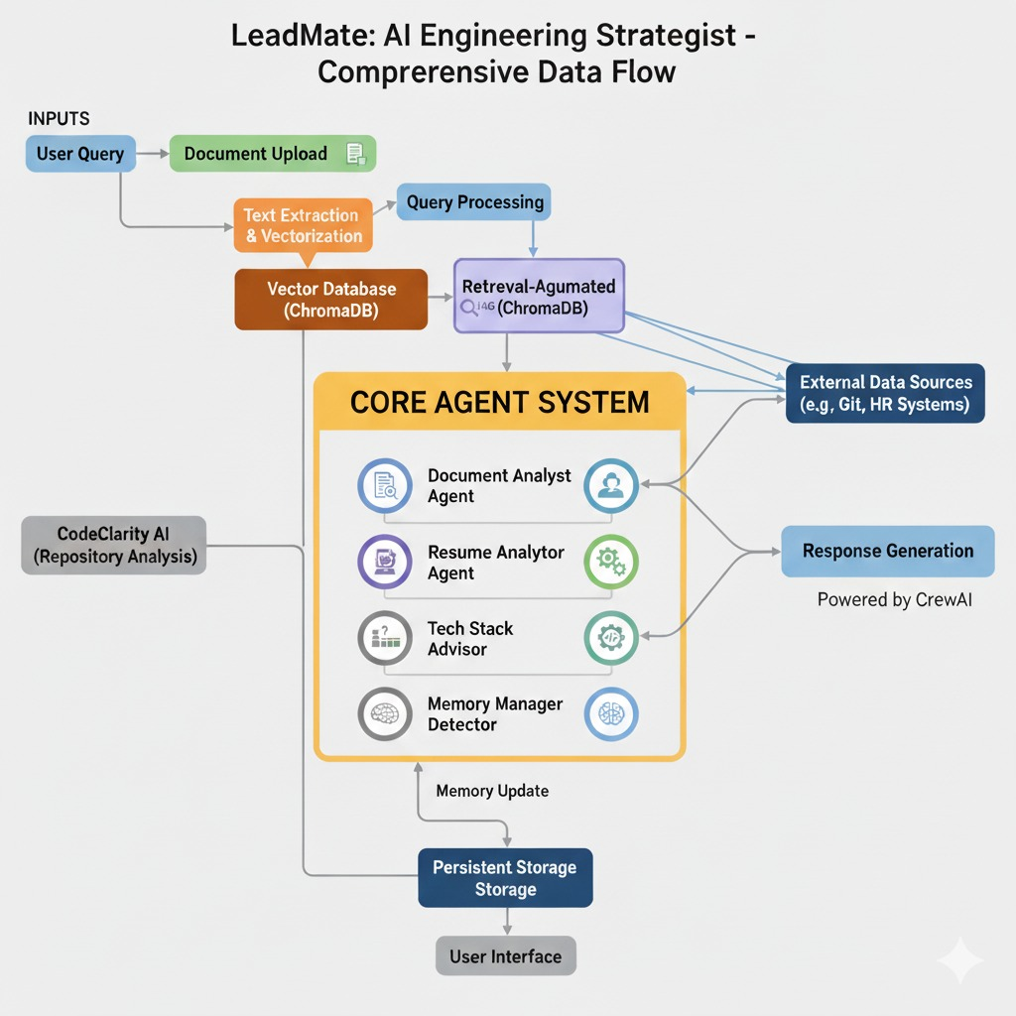
Proposed Methodology

Slide 15
Tools and Technologies
Frontend
React – Component-based UI framework
Vite– Fast build tool & bundler
Tailwind CSS– Responsive styling system
Backend
Python– Core backend language
FastAPI– REST API framework
CrewAI– Multi-agent orchestration
Ollama– Local LLM serving
ChromaDB– Vector database for semantic search
AI & ML
Llama 3.1 – Local language model
Sentence-Transformers– Embeddings for text vectorization
LangChain– Document chunking & processing
Scikit-learn– Pattern recognition & ML toolkit

Slide 16
Timeline / Workplan
Task | Nikunj | Sanjay | Vastav | Week 1 | Week 2 | Week 3 | Week 4 | Week 5 | Week 6 | Week 7 | Week 8
Literature Review & Problem Analysis | 🟢 | 🟢 | 🟢 | █████
Backend Setup (GitHub API, Data Fetch) | 🟢 |  |  |  | █████ |  |  |  | ███ |  | ████
AI Model Design (Commit Summarization, RAG) |  | 🟢 |  |  | █████ | █████ | █████ |  |  | █████
Frontend UI/UX Design | 🟢 |  | 🟢 |  |  | ████ | ████ | ██
Weekly Report Generation Feature |  | 🟢 | 🟢 | █████ |  |  | █████ |  |  | ████
Skill Gap Analysis Module |  | 🟢 |  | █████ |  |  | █████ | ███ | █████ |  | ███
Integration & Testing | 🟢 | 🟢 | 🟢 |  |  |  |  | █████ | █████ |  | █████
Documentation & Presentation | 🟢 | 🟢 | 🟢 | █████ | █████ |  |  |  |  | ███ | ████

Slide 17
Current Progress
AI Agent System – Fully Operational
Document Analyst Agent (DocAgent): Production ready with complete multi-format processing
Technology Stack Advisor Agent: Core features complete with comprehensive recommendations
2. Frontend Development – Near Completion
Core Application Structure - Complete
Layout and Navigation: Production ready with responsive design
Theme System: Complete implementation with smooth transitions
3. Dashboard Features – Complete
Manager Dashboard: Project management interface fully operational
Team Lead Dashboard: All features implemented including Kanban board
AI Assistant Interface: UI complete, backend integration pending
Workflow Visualization: Mock implementation complete
Progress Reporting: UI complete with structured templates
4. System Integration – Partial Completion
API Integration: Basic framework implemented, AI agent integration in progress
Data Flow Management: Architecture defined, real-time synchronization pending

Slide 18
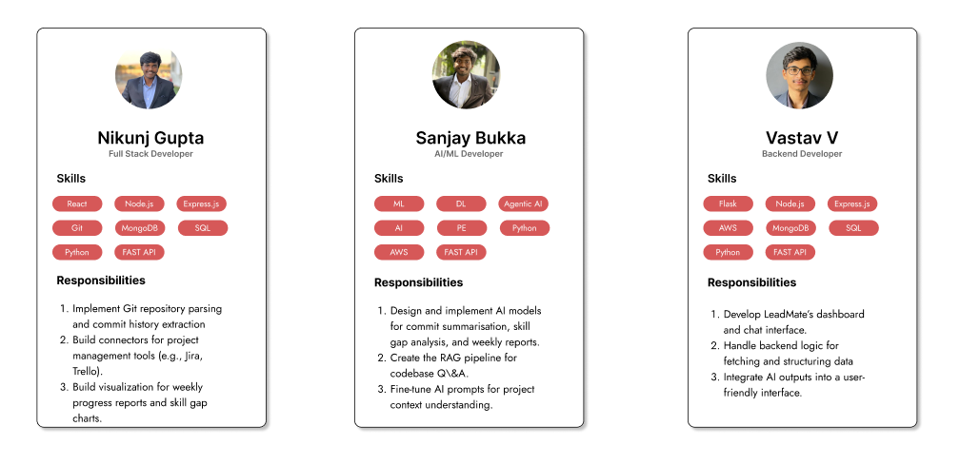
Team Member’s Roles & Contribution

Slide 19
Challenges Faced
Challenge | Impact | How We Addressed It
Large Language Model producing inconsistent response formats across queries | AI responses varied between JSON, plain text, and mixed formats | Implemented structured prompt engineering with explicit JSON schemas
Vector database queries becoming slow with large document collections | Search response times increased beyond acceptable thresholds | Implemented embedding caching strategy
Managing complex state across multiple dashboard components | Excessive prop drilling through component layers | Implemented multiple specialized Context providers
Tailwind CSS causing layout breaks on various screen sizes | Sidebar navigation overlapped content on tablets | Adopted mobile-first responsive design methodology

Slide 20
Future Scope
System Integration & API Completion Full Stack Integration:
Complete REST API with WebSocket support
Real-time Features: Live task board updates and notifications
Error Handling: Comprehensive error recovery and offline capabilities
2. Testing Implementation & Quality Assurance
Automated Testing: Jest/PyTest suite with comprehensive coverage
Performance Testing: Load testing for concurrent users
User Acceptance Testing: Stakeholder feedback and usability testing
3. Skill Gap Analysis Enhancement
Dynamic Assessment: Real-time skill evaluation from Git analysis
Learning Paths: Personalized training recommendations
Team Optimization: Advanced role assignment algorithms
4. AI Model Enhancement & Optimization
Response Quality: Advanced prompt engineering and caching
Performance Optimization: Faster inference and memory management
Predictive Analytics: Project success probability modeling

